Slide 1
Graduate Artificial Intelligence CS 640 Markov Decision Processes
Jeffrey Considine
jconsidi@bu.edu

Slide 2

Announcements
Shared Compute Cluster (SCC) Tutorial next class (9/25)
Bring your laptop!
Will walk through account setup and ways to access the SCC.
AI Research seminar (AIR)
Tuesdays 2-3pm @ CDS 1101

Slide 3
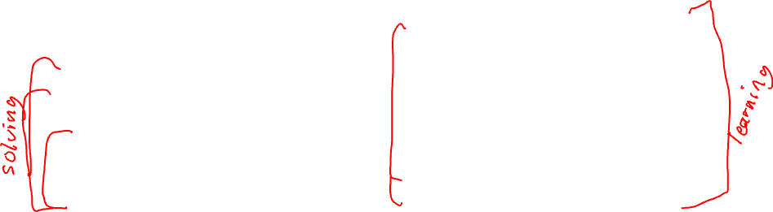
Updated Weekly Lecture Schedule
What is AI?
Responsible AI and Rule-based Systems
Searching and Planning
Markov Decision Processes
Computing Optimal Policies
Hidden Markov Models
Midterm
Neural Networks
Neural Networks and Polices
Computer Vision
Face Recognition and Pose Estimation
Natural Language Processing
Large Language Models
Game Playing
Logic and Planning

Slide 4
Plan for Today
Markov property and Markov processes
Markov reward processes
Markov decision processes
Policies (may spill over to next time)

Slide 5
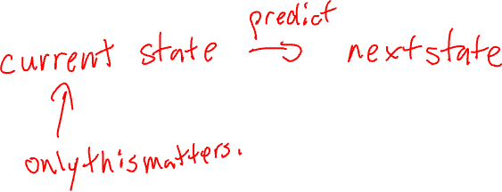
Markov Property
Only the current state matters to predict the future.
“memoryless”

Slide 6

Formalizing the Markov Property
If we know $S_{t}$, then $S_{1},S_{2},…, S_{t−1}$ do not matter.
$$Pr\left[S_{t+1}\right|S_{1},S_{2},…,S_{t}]=Pr[S_{t+1}|S_{t}]$$

Slide 7
Implications of the Markov Property
History does not matter once you fully know the current state.
However, more information may need to be included in the state to get a Markov process.
Physical simulations: velocity
Chess: past positions where 3-fold repetition rule might trigger.

Slide 8
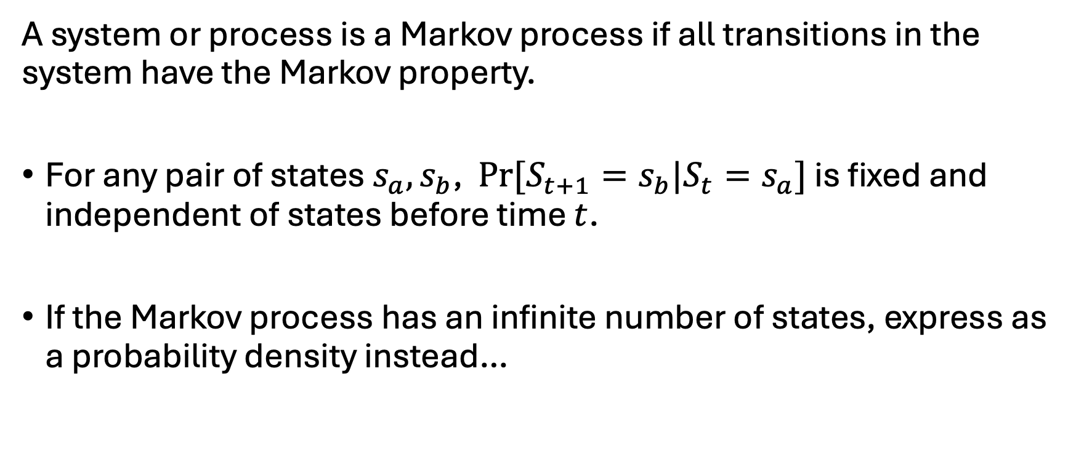
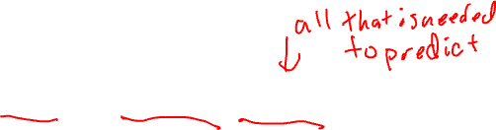
Markov Processes
A system or process is a Markov process if all transitions in the system have the Markov property.
For any pair of states $s_{a},s_{b}$, $Pr[S_{t+1}=s_{b}|S_{t}=s_{a}]$ is fixed and independent of states before time $t$.
If the Markov process has an infinite number of states, express as a probability density instead…

Slide 9
Examples of Markov Processes
Physics
Weather
Users engaging with a web site?
Autocorrect typing analysis
Credit card fraud detection

Slide 10
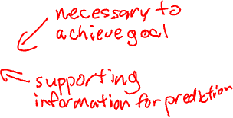
General State Representations
First pass at identifying state –
Write down everything that you care to observe later.
Write down everything that might affect the future.
Often looks like a tuple of many features. 🚰
If each of these features has a finite number of values, then the Markov process will have a finite number of states.
Rounding to make features discrete and finite may compromise prediction power.
Precision hidden by rounding may affect probabilities.

Slide 11
Variations on Markov Processes
Finite vs infinite
Discrete vs continuous time
Fully observable vs hidden state (covered in 2 weeks)
These apply to all the Markov variations covered later, but we will focus on finite, discrete and fully observable cases.

Slide 12
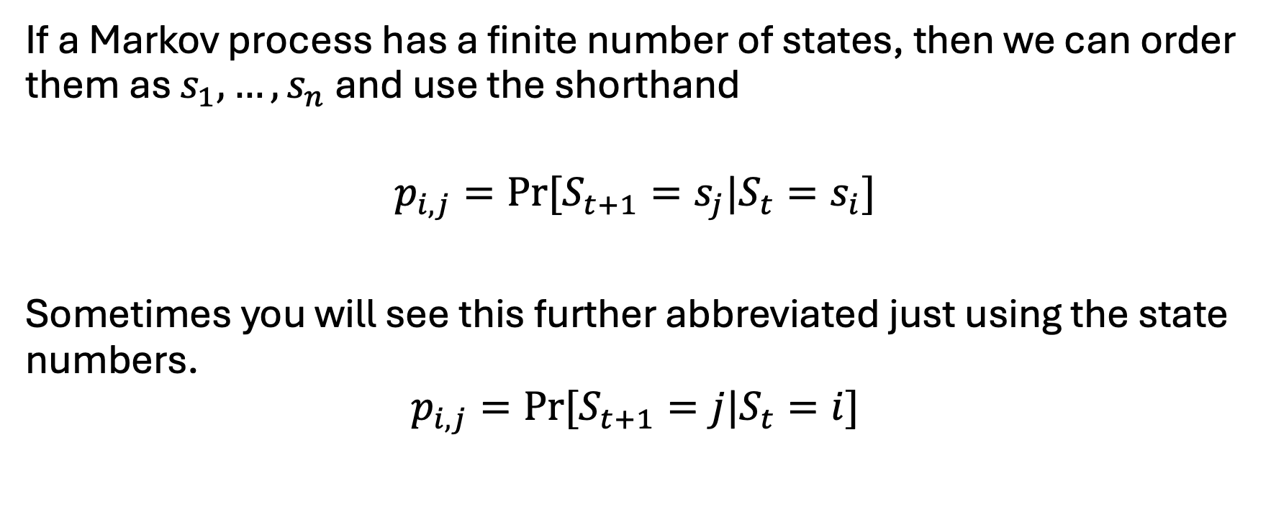
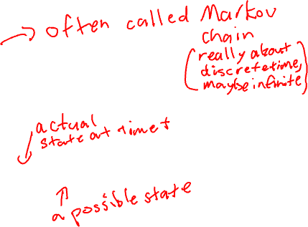
Finite Markov Processes
If a Markov process has a finite number of states, then we can order them as $s_{1},…, s_{n}$ and use the shorthand
$$p_{i,j}=Pr[S_{t+1}=s_{j}|S_{t}=s_{i}]$$
Sometimes you will see this further abbreviated just using the state numbers.
$$p_{i,j}=Pr[S_{t+1}=j|S_{t}=i]$$

Slide 13
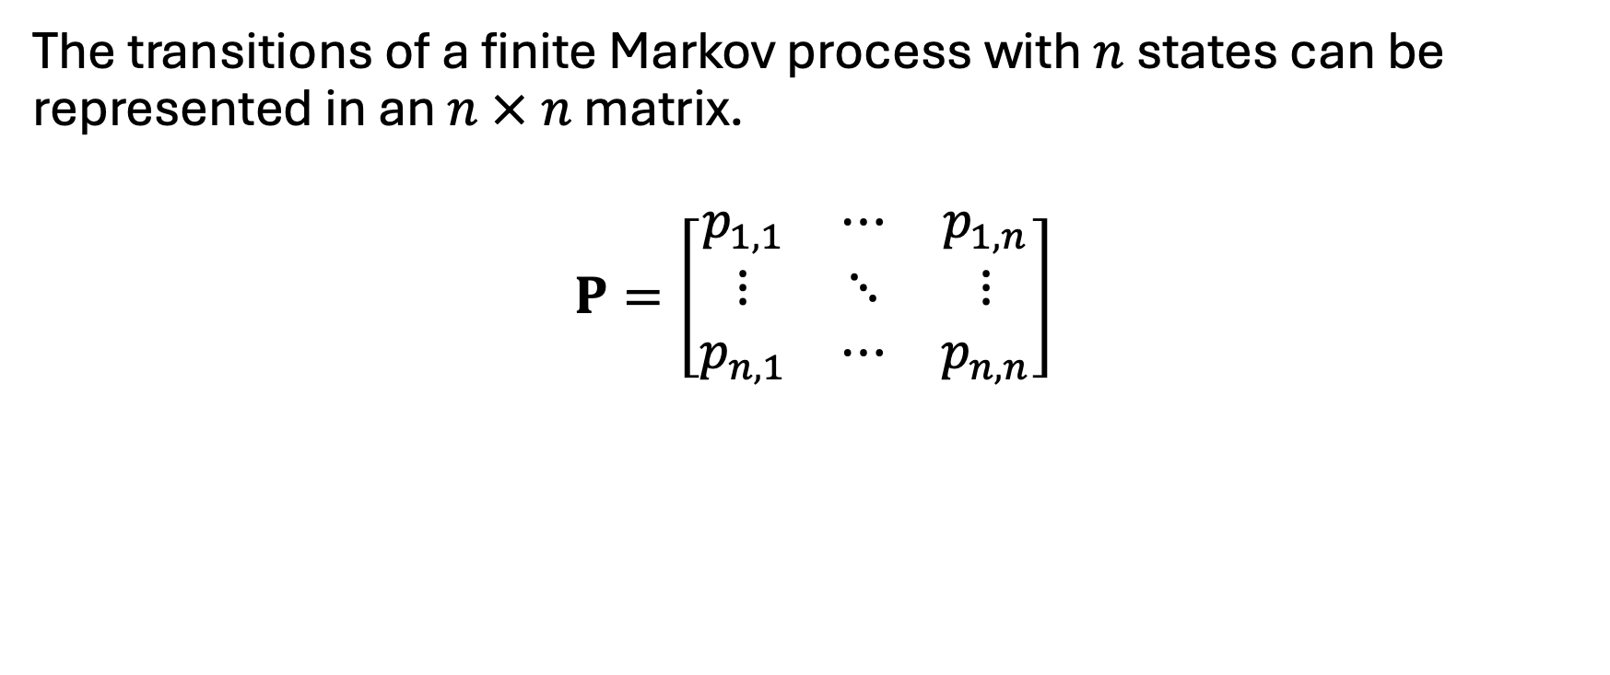

Transition Matrices
The transitions of a finite Markov process with $n$ states can be represented in an $n × n$ matrix.
$$P=\left[\begin{matrix}p_{1,1} & ⋯ & p_{1,n} \\ ⋮ & ⋱ & ⋮ \\ p_{n,1} & ⋯ & p_{n,n}\end{matrix}\right]$$

Slide 14
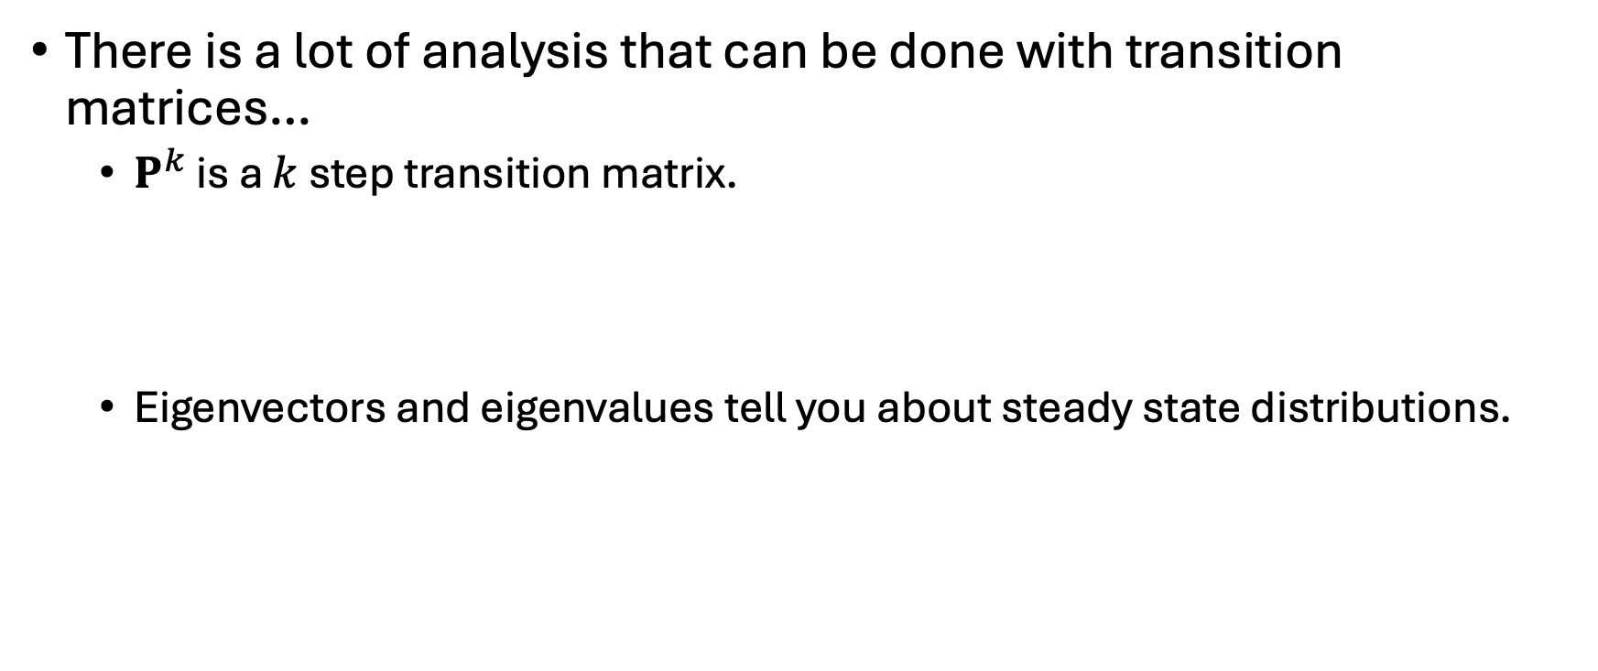
Tricks with Transition Matrices
There is a lot of analysis that can be done with transition matrices…
$P^{k}$ is a $k$ step transition matrix.
Eigenvectors and eigenvalues tell you about steady state distributions.

Slide 15
Any Questions?
???

Slide 16
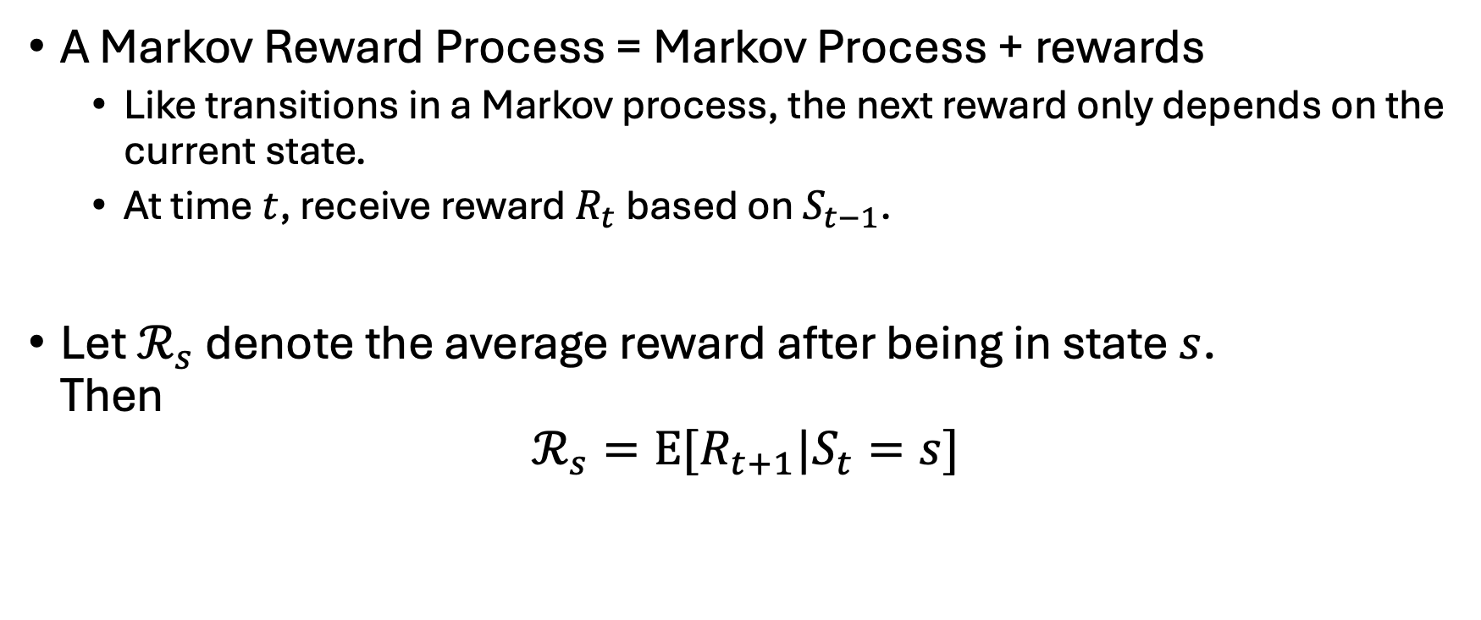
Markov Reward Processes
A Markov Reward Process = Markov Process + rewards
Like transitions in a Markov process, the next reward only depends on the current state.
At time $t$, receive reward $R_{t}$ based on $S_{t−1}$.
Let $ℛ_{s}$ denote the average reward after being in state $s$. Then
$$ℛ_{s}=E[R_{t+1}|S_{t}=s]$$

Slide 17
Examples of Markov Reward Processes
Weather – rewards are enjoying sun vs getting soaked…
User on web site – did they do something that made us money?

Slide 18
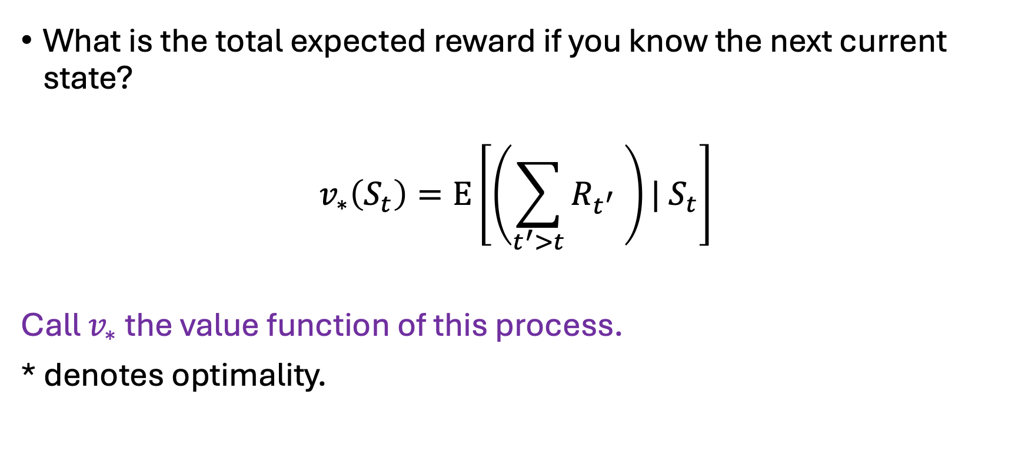
Evaluating Markov Reward Processes (take 1)
What is the total expected reward if you know the next current state?
$$v_{∗}\left(S_{t}\right)=E\left[\left(\sum_{t^{′}>t}{R_{t^{′}} }\right)| S_{t}\right]$$
Call $v_{∗}$ the value function of this process.
* denotes optimality.

Slide 19
What about Loops?
???

Slide 20
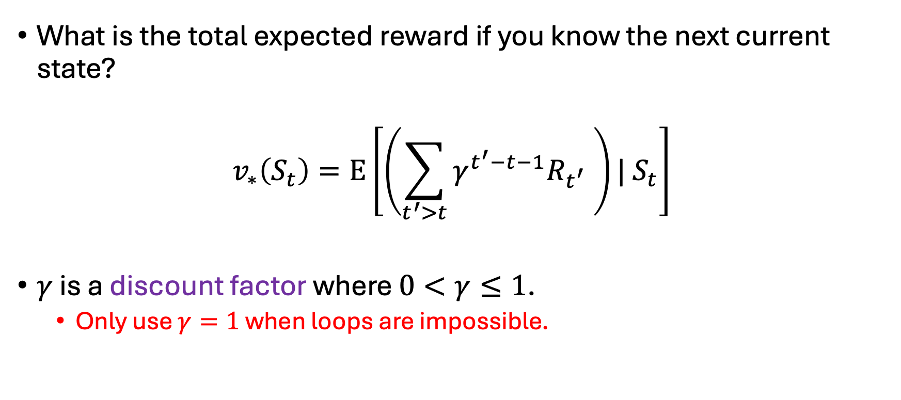

Evaluating Markov Reward Processes (take 2)
What is the total expected reward if you know the next current state?
$$v_{∗}\left(S_{t}\right)=E\left[\left(\sum_{t^{′}>t}{γ^{t^{′}−t−1}R_{t^{′}} }\right)| S_{t}\right]$$
$γ$ is a discount factor where $0<γ≤1$.
Only use $γ=1$ when loops are impossible.

Slide 21
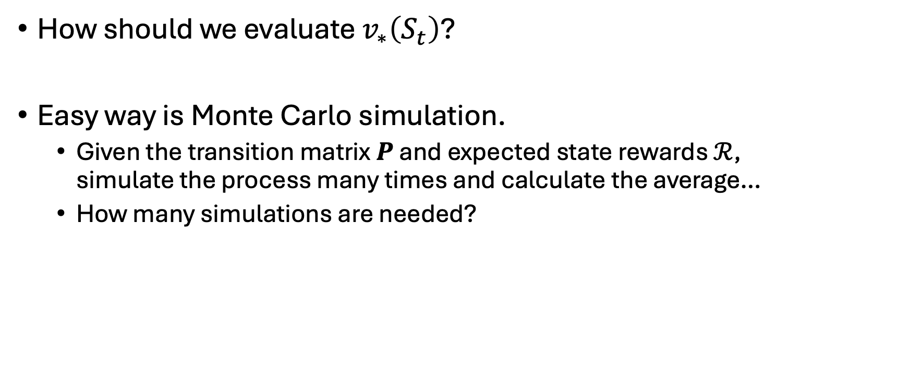
Monte Carlo Evaluation of Markov Reward Process
How should we evaluate $v_{∗}\left(S_{t}\right)$?
Easy way is Monte Carlo simulation.
Given the transition matrix $P$ and expected state rewards $ℛ$, simulate the process many times and calculate the average…
How many simulations are needed?

Slide 22
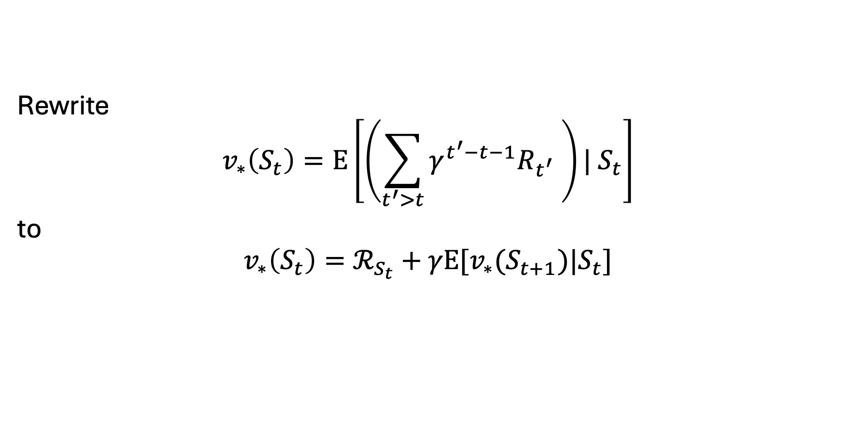
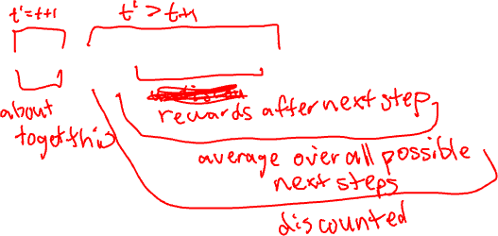
Evaluating Markov Reward Processes (take 3)
Rewrite
$$v_{∗}\left(S_{t}\right)=E\left[\left(\sum_{t^{′}>t}{γ^{t^{′}−t−1}R_{t^{′}} }\right)| S_{t}\right]$$
to
$$v_{∗}\left(S_{t}\right)=ℛ_{S_{t}}+γE[v_{∗}(S_{t+1})|S_{t}]$$

Slide 23
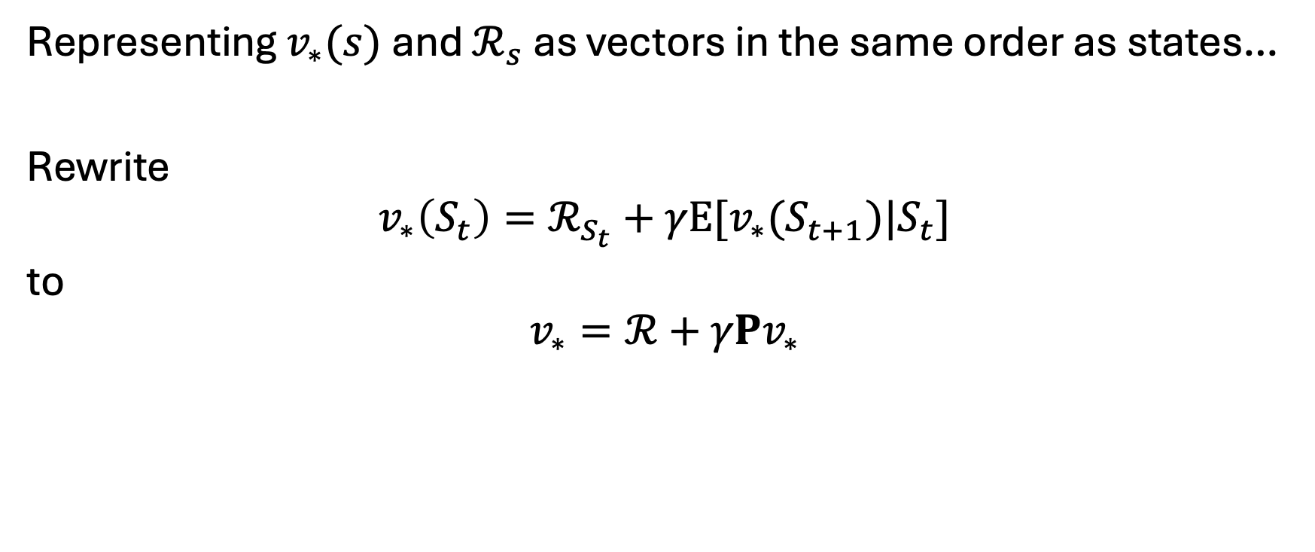

Solving Markov Reward Processes (part 1)
Representing $v_{∗}(s)$ and $ℛ_{s}$ as vectors in the same order as states…
Rewrite
$$v_{∗}\left(S_{t}\right)=ℛ_{S_{t}}+γE[v_{∗}(S_{t+1})|S_{t}]$$
to
$$v_{∗}=ℛ+γPv_{∗}$$

Slide 24


Solving Markov Reward Processes (part 2)
Then (linear) algebra as follows.
$$v_{∗}=ℛ+γPv_{∗}$$
$$v_{∗}−γPv_{∗}=ℛ$$
$$(I−γP)v_{∗}=ℛ$$
$$v_{∗}={\left(I−γP\right)}^{−1}ℛ$$

Slide 25
Any Questions?
???

Slide 26
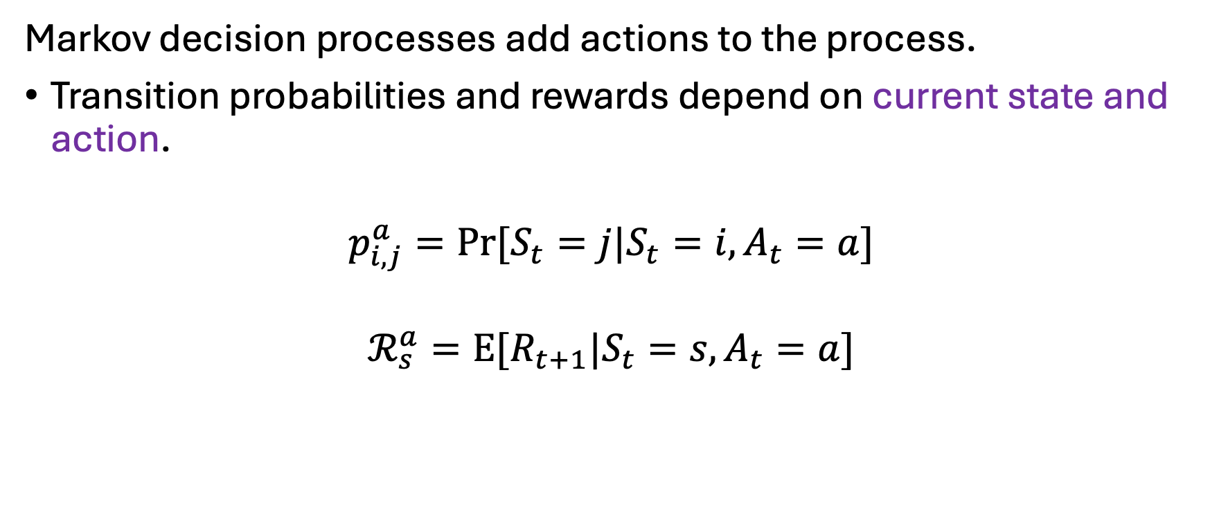

Markov Decision Processes (MDPs)
Markov decision processes add actions to the process.
Transition probabilities and rewards depend on current state and action.
$$p_{i,j}^{a}=Pr[S_{t}=j|S_{t}=i,A_{t}=a]$$
$$ℛ_{s}^{a}=E[R_{t+1}|S_{t}=s,A_{t}=a]$$

Slide 27
Examples of Markov Decision Processes
Weather + take an umbrella decision
Driving and delays (negative rewards)
This is our super generic model for decision making.
The catch is it is too generic.
Hidden state makes this really hard!

Slide 28
Markov Decision Processes vs Search
Nodes are states.
Edges are transitions.
Choices of edges are actions.
Usually a lot fewer actions than nodes/states.
Probabilistic component of MDPs allows probabilistic next nodes.
Deterministic transitions give “easy” search problem.
Probabilistic transitions break search algorithms.

Slide 29
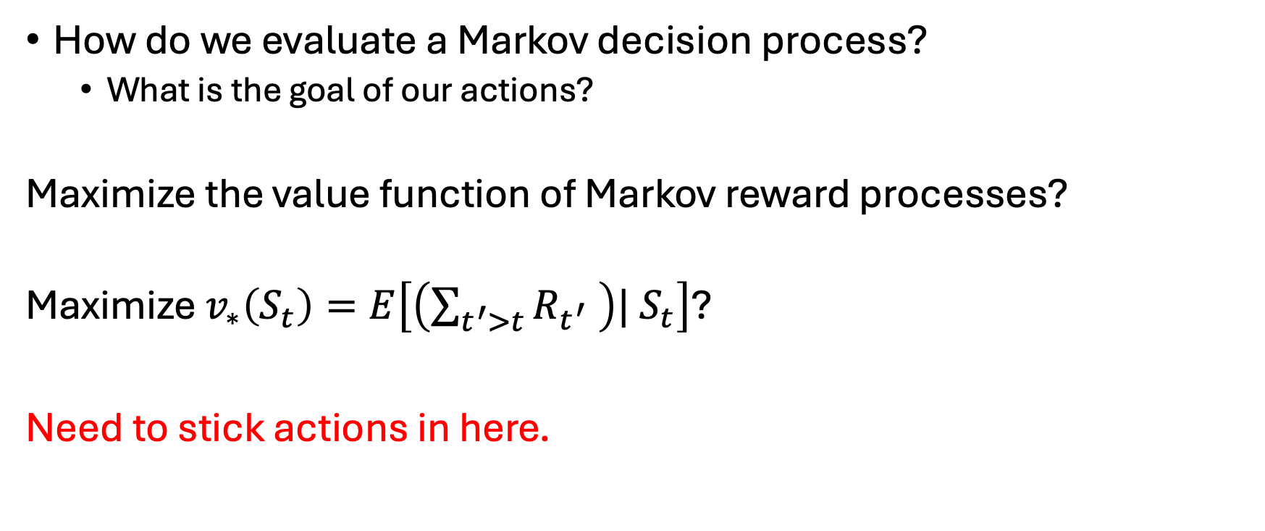
Evaluating Markov Decision Processes (take 1)
How do we evaluate a Markov decision process?
What is the goal of our actions?
Maximize the value function of Markov reward processes?
Maximize $v_{∗}\left(S_{t}\right)=E\left[\left(\sum_{t^{′}>t}{R_{t^{′}} }\right)| S_{t}\right]$?
Need to stick actions in here.

Slide 30
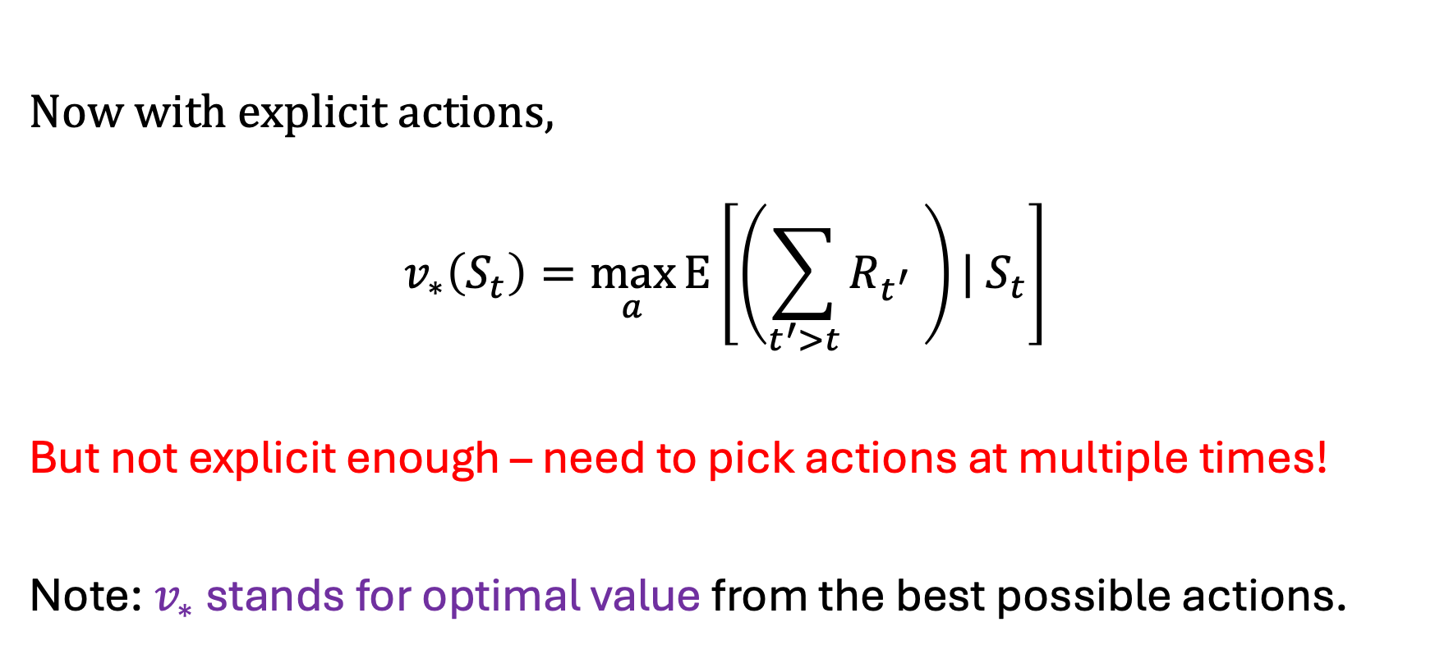
Evaluating Markov Decision Processes (take 2)
Now with explicit actions,
$$v_{∗}\left(S_{t}\right)=\max_{a}{E\left[\left(\sum_{t^{′}>t}{R_{t^{′}} }\right)| S_{t}\right]}$$
But not explicit enough – need to pick actions at multiple times!
Note: $v_{∗}$ stands for optimal value from the best possible actions.

Slide 31
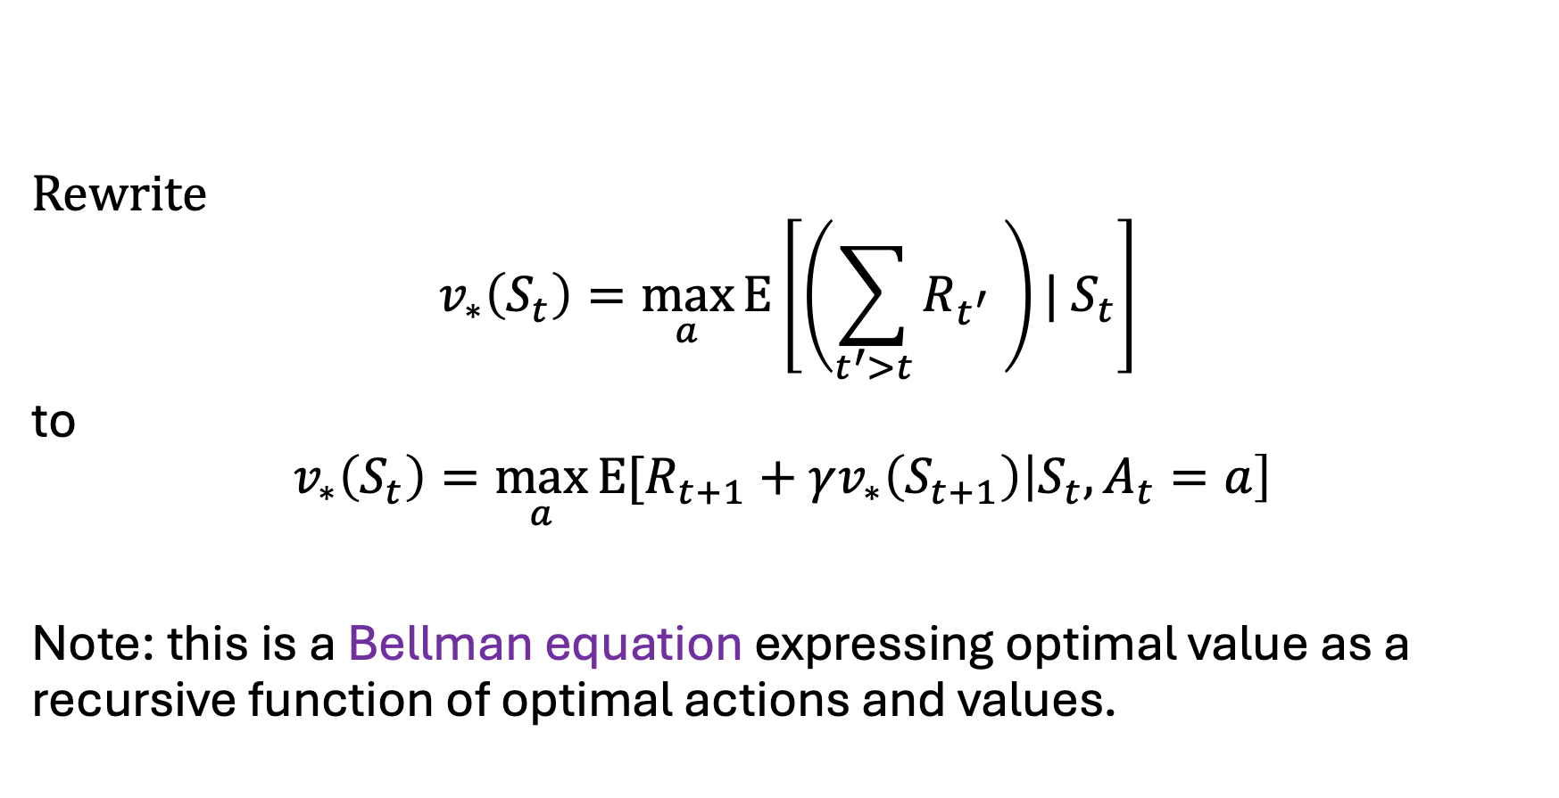
Evaluating Markov Decision Processes (take 3)
Rewrite
$$v_{∗}\left(S_{t}\right)=\max_{a}{E\left[\left(\sum_{t^{′}>t}{R_{t^{′}} }\right)| S_{t}\right]}$$
to
$$v_{∗}\left(S_{t}\right)=\max_{a}{E[R_{t+1}}+γv_{∗}\left(S_{t+1}\right)\left|S_{t},A_{t}=a\right]$$
Note: this is a Bellman equation expressing optimal value as a recursive function of optimal actions and values.

Slide 32
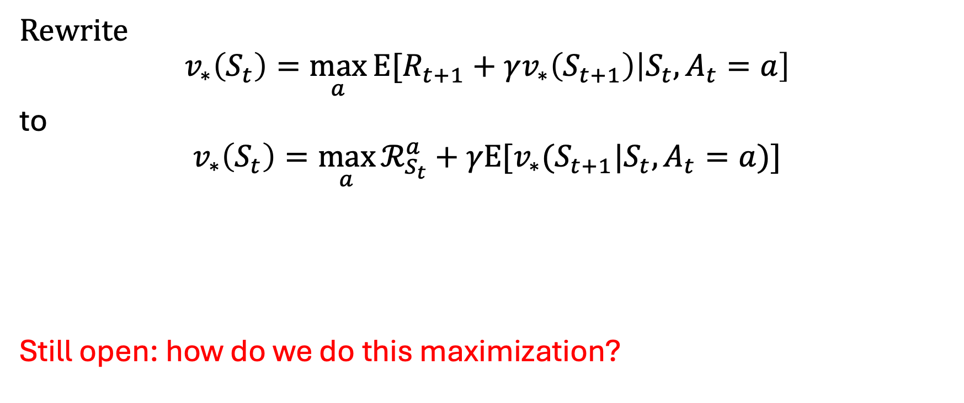
Evaluating Markov Decision Processes (take 4)
Rewrite
$$v_{∗}\left(S_{t}\right)=\max_{a}{E[R_{t+1}}+γv_{∗}\left(S_{t+1}\right)\left|S_{t},A_{t}=a\right]$$
to
$$v_{∗}\left(S_{t}\right)=\max_{a}{ℛ_{S_{t}}^{a}+γE[v_{∗}(S_{t+1}|S_{t},A_{t}=a)]}$$
Still open: how do we do this maximization?

Slide 33
Any Questions?
???

Slide 34
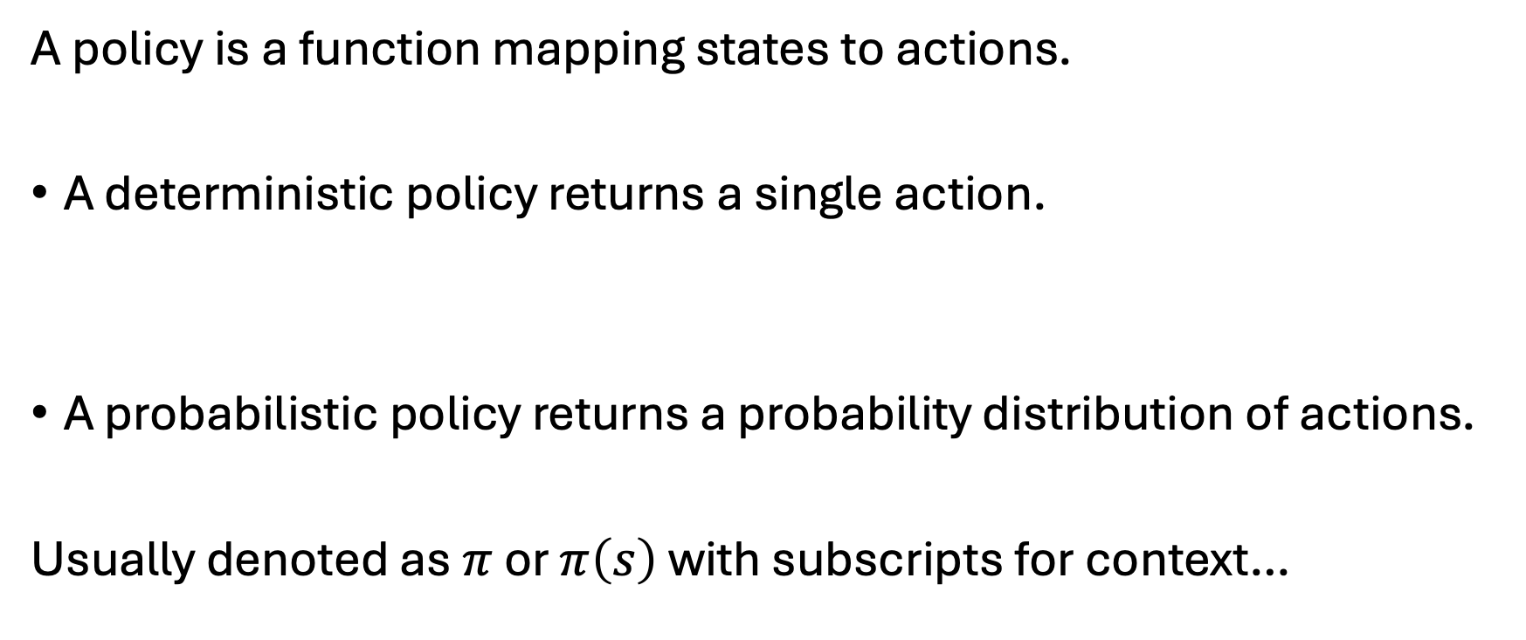
What is a Policy?
A policy is a function mapping states to actions.
A deterministic policy returns a single action.
A probabilistic policy returns a probability distribution of actions.
Usually denoted as $π$ or $π\left(s\right)$ with subscripts for context…

Slide 35
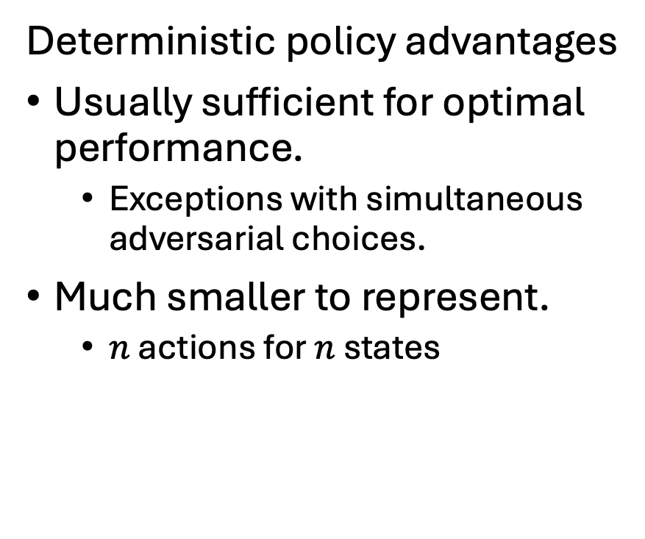
Probabilistic vs Deterministic Policies
Deterministic policy advantages
Usually sufficient for optimal performance.
Exceptions with simultaneous adversarial choices.
Much smaller to represent.
$n$ actions for $n$ states
Probabilistic policy advantages
Can always represent deterministic policies.
All probability on one action.
Often convenient for numerical optimizations.

Slide 36

Representing Policies for Finite MDPs
Represent a deterministic policy $π$ as a table of $n$ actions.
Represent a probabilistic policy $π$ as an $n × k$ matrix for $n$ states and $k$ actions.

Slide 37
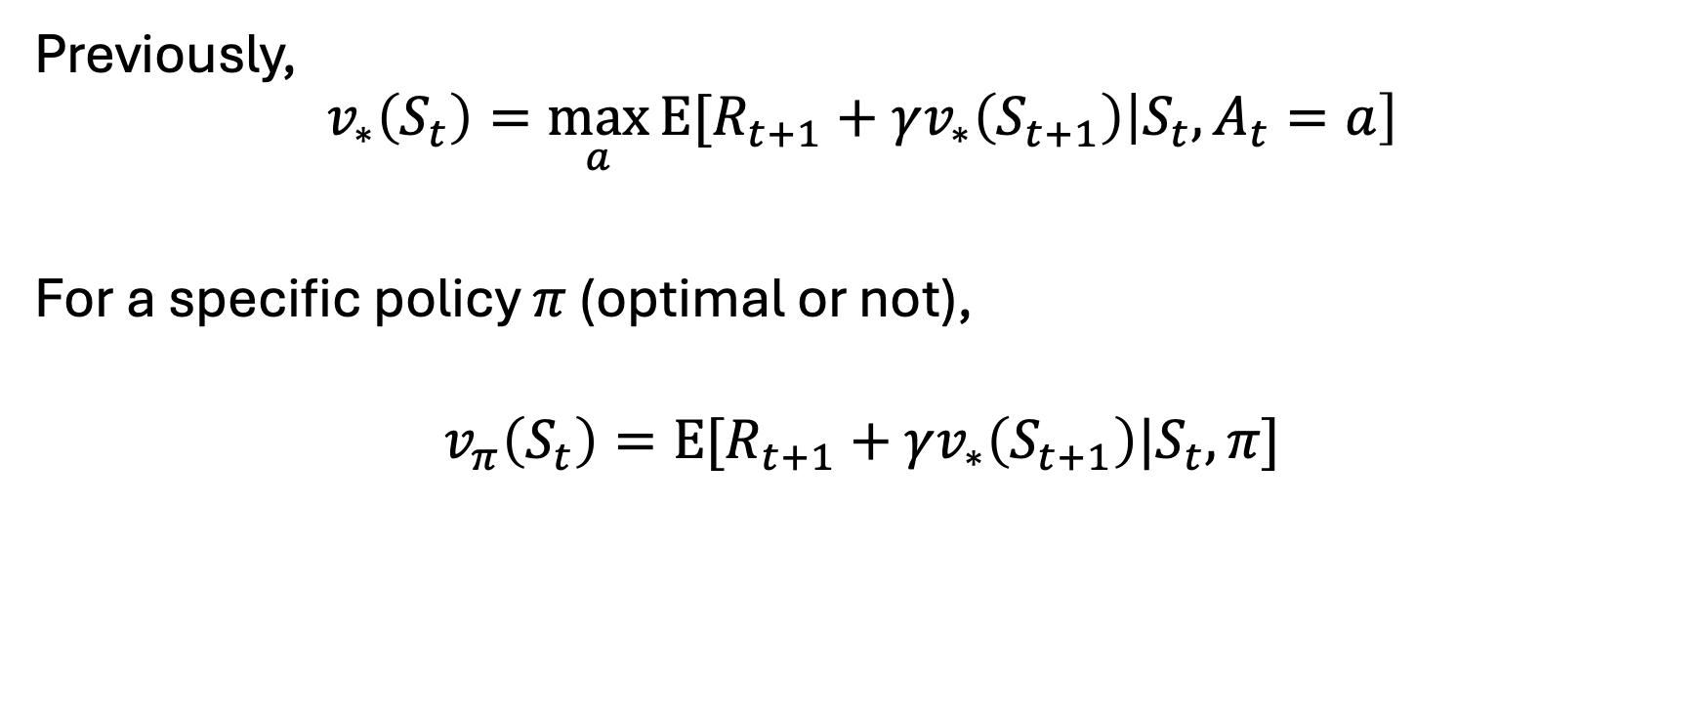
Evaluating Policies for MDPs (take 1)
Previously,
$$v_{∗}\left(S_{t}\right)=\max_{a}{E[R_{t+1}}+γv_{∗}\left(S_{t+1}\right)\left|S_{t},A_{t}=a\right]$$
For a specific policy $π$ (optimal or not),
$$v_{π}\left(S_{t}\right)=E[R_{t+1}+γv_{∗}\left(S_{t+1}\right)|S_{t}, π]$$

Slide 38

Evaluating Policies for MDPs (take 2)
Rewrite
$$v_{π}\left(S_{t}\right)=E[R_{t+1}+γv_{∗}\left(S_{t+1}\right)|S_{t}, π]$$
to
$$v_{π}\left(S_{t}\right)=E\left[R_{t+1} | S_{t},π\right]+γE[v_{π}\left(S_{t},π\right)]$$

Slide 39
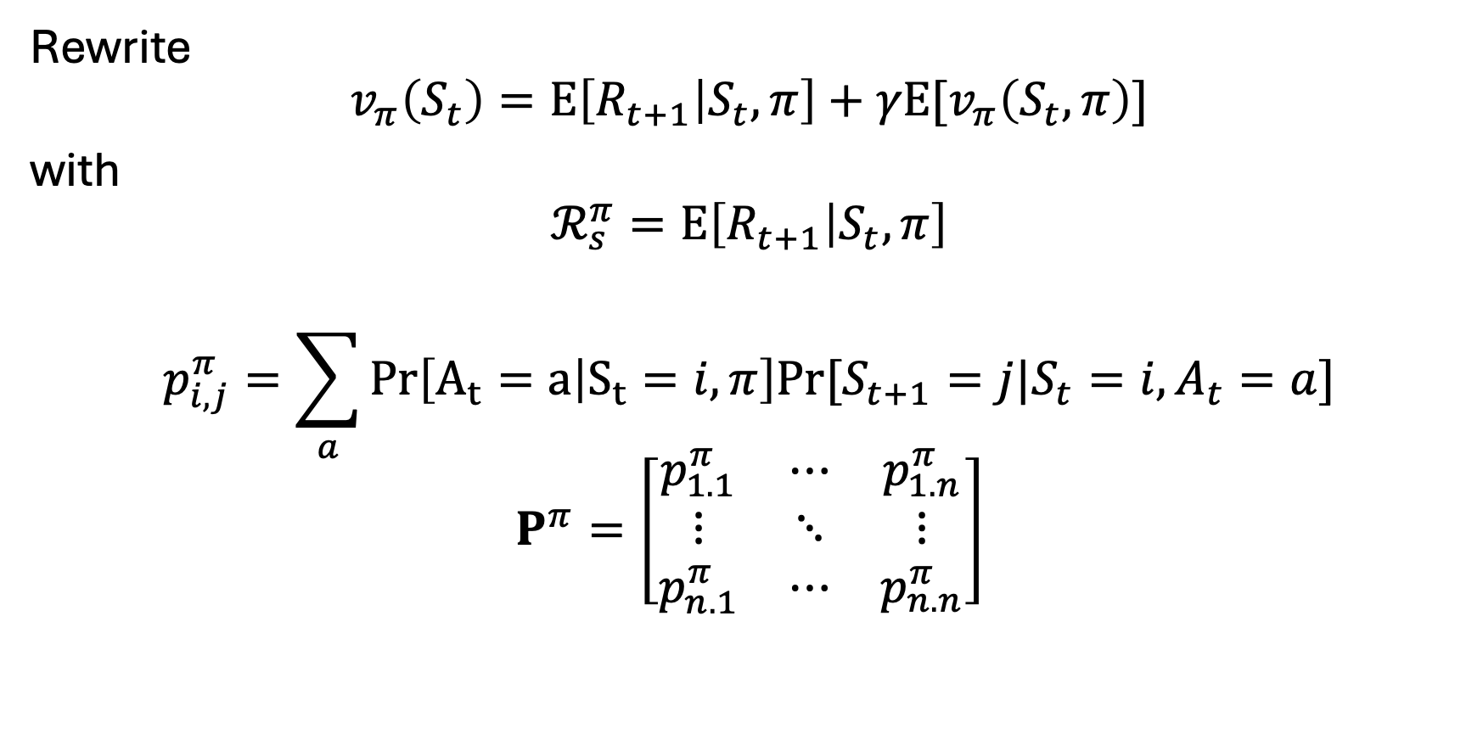
Evaluating Policies for MDPs (take 3a)
Rewrite
$$v_{π}\left(S_{t}\right)=E\left[R_{t+1} | S_{t},π\right]+γE[v_{π}\left(S_{t},π\right)]$$
with
$$ℛ_{s}^{π}=E\left[R_{t+1} | S_{t},π\right]$$
$$p_{i,j}^{π}=\sum_{a}{Pr\left[A_{t}=a | S_{t}=i,π\right]Pr⁡[S_{t+1}=j|S_{t}=i,A_{t}=a]}$$
$$P^{π}=\left[\begin{matrix}p_{1.1}^{π} & ⋯ & p_{1.n}^{π} \\ ⋮ & ⋱ & ⋮ \\ p_{n.1}^{π} & ⋯ & p_{n.n}^{π}\end{matrix}\right]$$

Slide 40
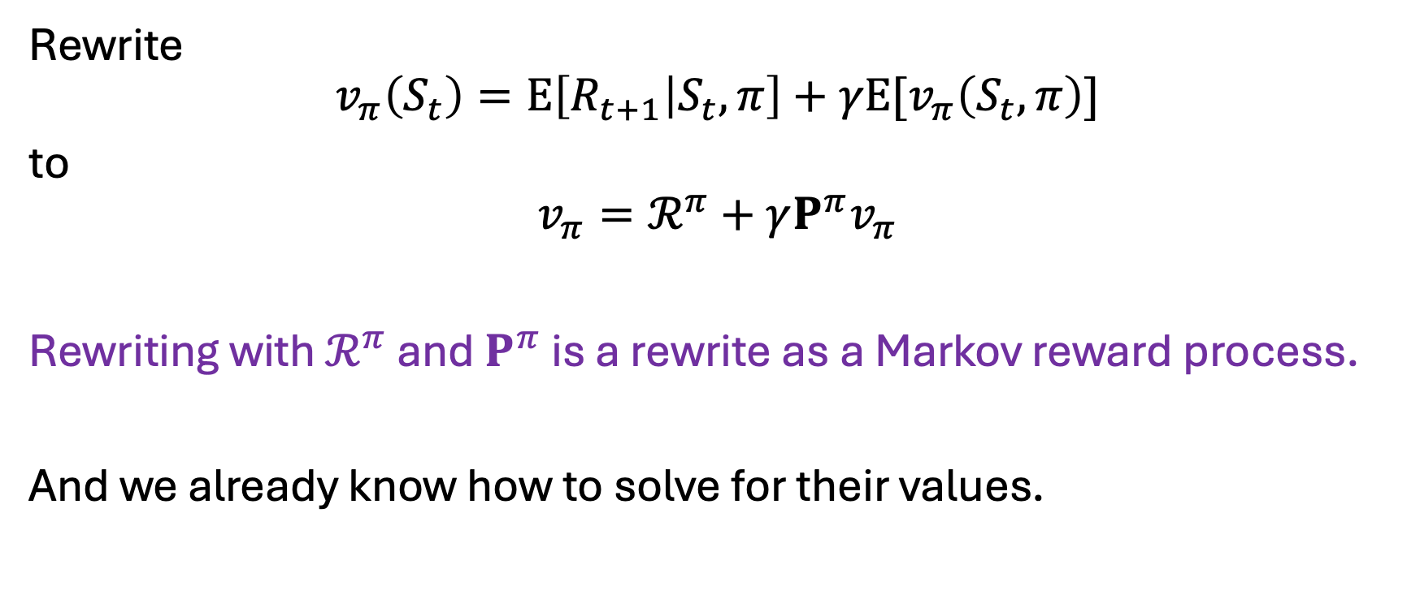
Evaluating Policies for MDPs (take 3b)
Rewrite
$$v_{π}\left(S_{t}\right)=E\left[R_{t+1} | S_{t},π\right]+γE[v_{π}\left(S_{t},π\right)]$$
to
$$v_{π}=ℛ^{π}+γP^{π}v_{π}$$
Rewriting with $ℛ^{π}$ and $P^{π}$ is a rewrite as a Markov reward process.
And we already know how to solve for their values.

Slide 41
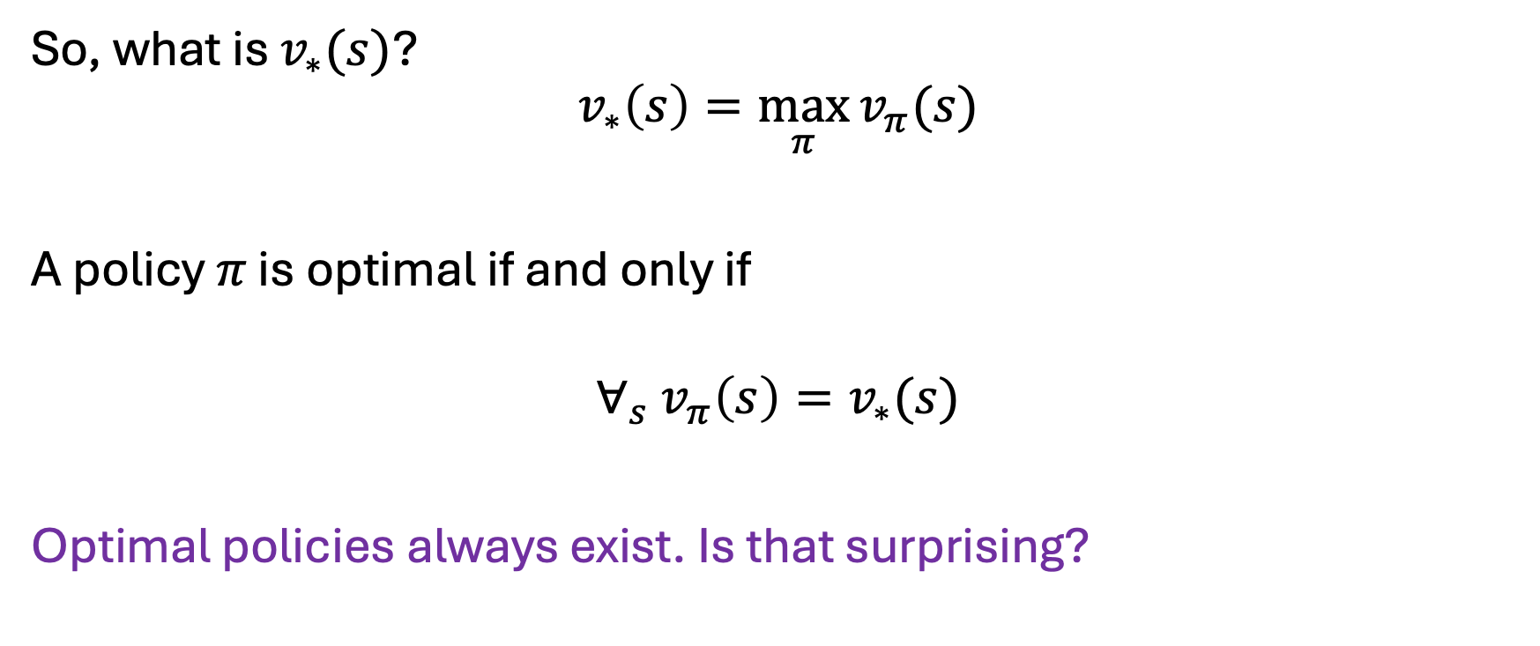
What is an Optimal Policy?
So, what is $v_{∗}(s)$?
$$v_{∗}\left(s\right)=\max_{π}{v_{π}(s)}$$
A policy $π$ is optimal if and only if
$$∀_{s} v_{π}\left(s\right)=v_{∗}(s)$$
Optimal policies always exist. Is that surprising?

Slide 42
Conclusions
MRPs are easy to evaluate.
MDP + policy = MRP
But how do we pick an optimal policy?

Slide 43
Any Questions?
???

